Slide 1


Slide 2








Hotel Management System
HMS, a flexible hotel management software that can
Manage the hotel records efficiently. It stores all the customers related data such as name, address, phone number, email, etc.. And booking related information like check in date and time period, etc..
A comprehensive solution in Property Management Systems (PMS) for hotels, hotel chains, resorts, motels, Restaurants, cafés, inns, etc.
The language used in this project is C.

Slide 3

OBJECTIVE
The objectives accomplished after the completion of this project are: -
Gathering more knowledge about c and how to implement in my project
Taking ideas from different websites, which have explained the concept.
Resolving the issues while implementing the codes and comparing it with the other codes to get the better result.
Finding the best way to represent the time date format.
Taking ideas from different websites (such as colour, format).

Slide 4




Modules
Admin Module
User Module
Employee Module
Report Module
Item Master Module

Slide 5
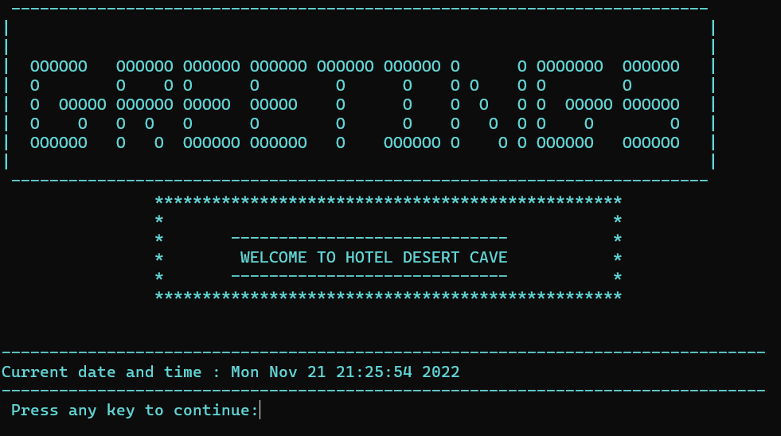
Screenshot(Welcome)

Slide 6
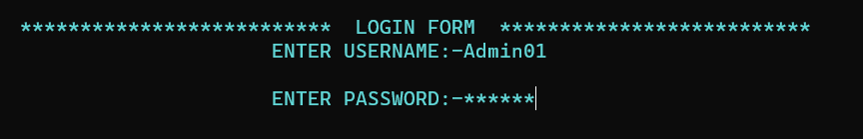
Screenshot(Login Page)

Slide 7
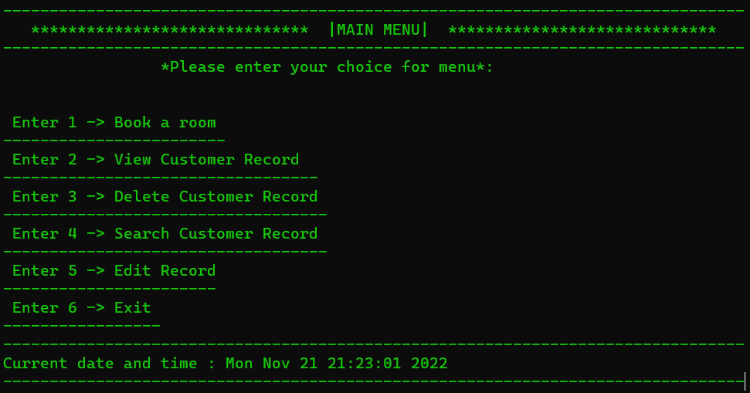
Screenshot(Main Menu)

Slide 8
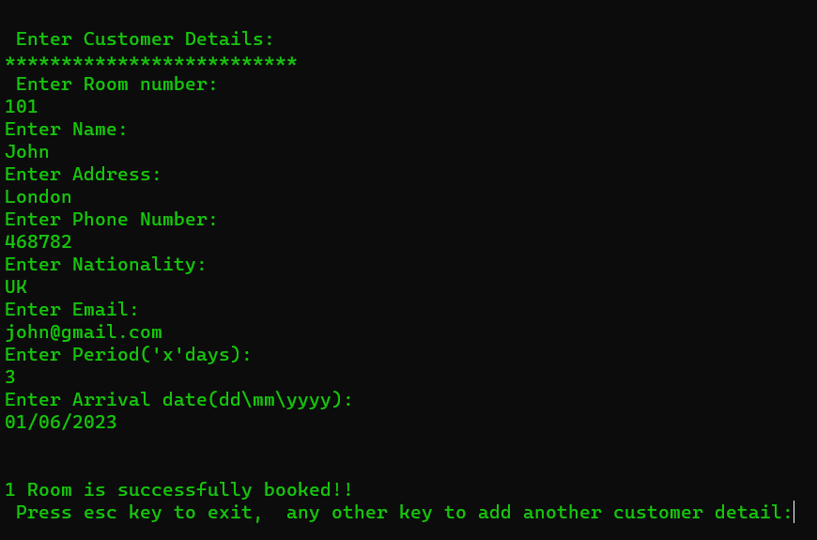
Screenshot(Booking a Room)

Slide 9
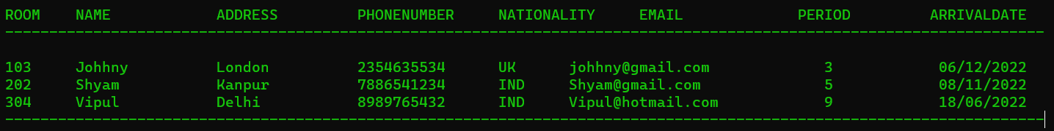
Screenshot(Viewing all Customers Record)

Slide 10
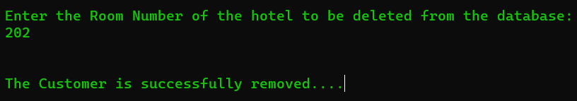
Screenshot(Deleting a Customer Record)

Slide 11
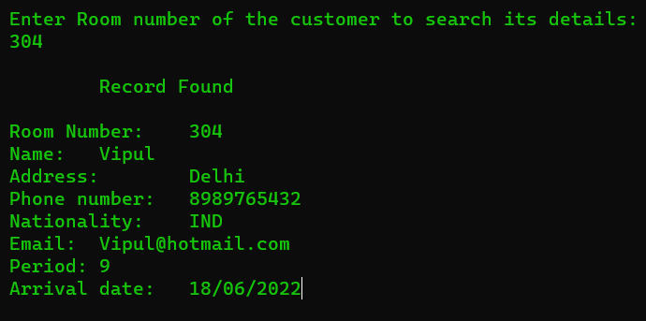
Screenshot(Searching a Customer Record)

Slide 12
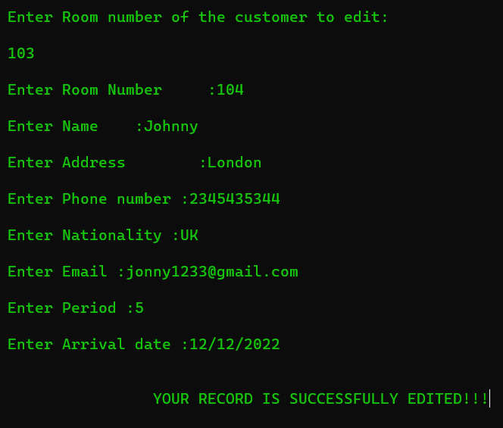
Screenshot(Editing a Record)

Slide 13
FUTURE SCOPE
At present this software does not contain credit card facility.
We can add the facility of pickup and drop where the costumer wants to go in the city, we can drop them at free of cost.
So as the demand increases, we can add this module as future scope.

Slide 14
HARDWARE REQUIREMENTS
Recommended Processor – 2nd generation Intel core or newer, or AMD
Recommended 250MB disk space
Recommended 2GB Ram

Slide 15
SOFTWARE REQUIREMENTS
Dev C++ OR Visual Studio Code
Windows 7/8/10/11 (Recommended)
GCC compiler
Codeblocks

Slide 16
CONCLUSION
The entire project has been developed and deployed as per the requirements stated by the user. Any specification untraced errors will be concentrated in the coming versions, which are planned to be developed in near future. The system at present does not take care of the money payment methods, as the consolidated constructs need SSL standards and are critically to be initiated in the first face, the application of the credit card transactions is applied as a developmental phase in the coming days. The system needs more elaborative technicality for its inception and evolution.

Slide 17

Thank You

